Slide 1
EDA CASE STUDY
Understand the consumer and loan attributes influencing the tendency of defaulters
SREELAKSHMI GOPALAKRISHAN
ZEP ANALYTICS-DATASCIENCE BOOT CAMP

Slide 2
PROBLEM STATEMENT
Identify patterns that indicates client difficulty for paying their installments.
Taking actions such as:
denying the loan
reducing the amount of loan
lending (to risky applicants) at a higher interest rate

Slide 3
OBJECTIVES
Identify the driving factors (or driver variables)behind loan default, i.e. the variables which are strong indicators of default.
Utilize the knowledge for company portfolio and risk assessment.

Slide 4
DATA IMBALANCE
Imbalance ratio (IR), defined as the ratio of the number of instances in the majority class to the number of examples in the minority class.
Target - 1 - client with payment difficulties: he/she had late payment more than X days on at least one of the first Y installments of the loan in our sample.
Target - 0 - all other cases.
Imbalance = Target - 0 / Target - 1 =11.55

Slide 5
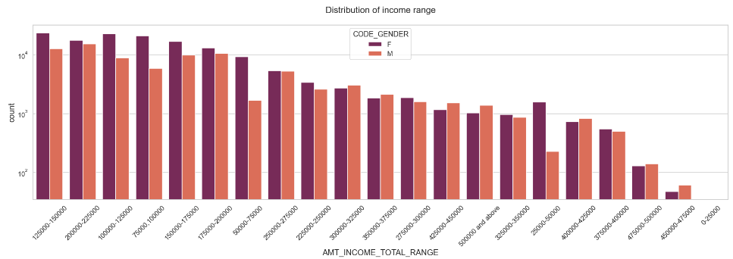
UNIVARIATE ANALYSIS - TARGET - 0 CASE (Income range distribution)
Female counts higher than male.
Lesser female in the income range 450000-475000.
Maximum female count observed in the range 100000-125000.

Slide 6
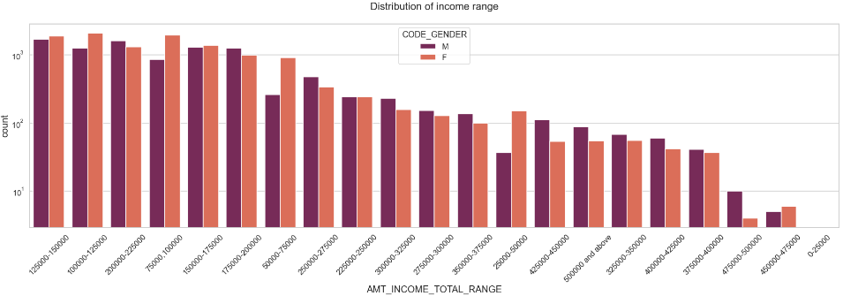
UNIVARIATE ANALYSIS - TARGET - 1 CASE (Income range distribution)
Male counts higher than female.
Lesser female in the income range 475000-500000.
Maximum female count observed in the range 75000-150000.

Slide 7
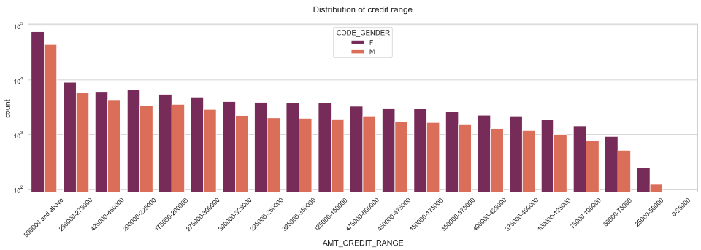
UNIVARIATE ANALYSIS - TARGET - 0 CASE (Credit range distribution)
Female counts higher than male.
Lesser female and male count in the income range 25000-50000.

Slide 8
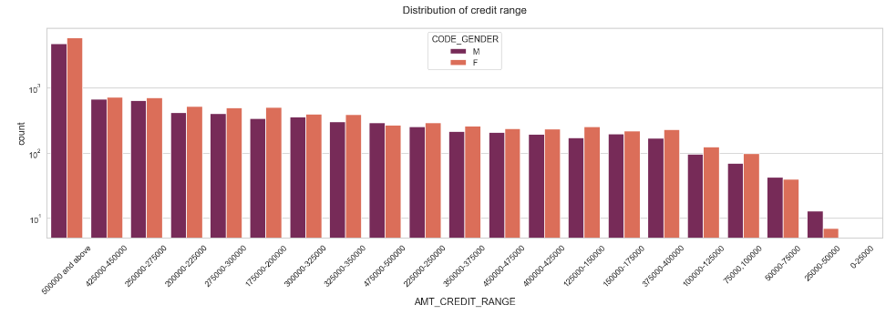
UNIVARIATE ANALYSIS - TARGET - 1 CASE (Credit range distribution)
Female counts higher than male at 500000 and above.
Equal count observed for all credit ranges.
Maximum male count observed in the range 25000-50000.

Slide 9
UNIVARIATE ANALYSIS - TARGET - 0 CASE (Credit range distribution)
Female counts higher than male.
Lesser female and male count in the income range 25000-50000.

Slide 10
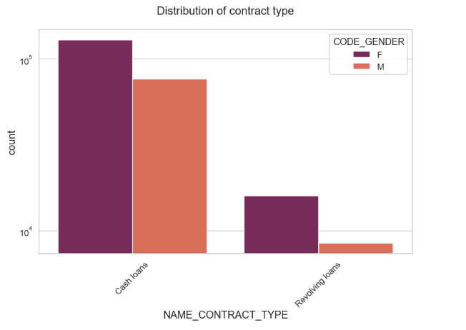
UNIVARIATE ANALYSIS - TARGET - 0 CASE (Contract type distribution)
Cash loans are higher than Revolving loans.
Higher female count for cash loan.

Slide 11
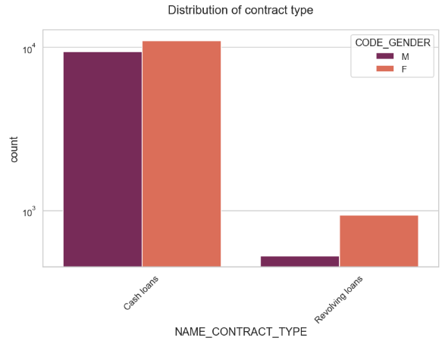
UNIVARIATE ANALYSIS - TARGET – 1 CASE (Contract type distribution)
Cash loans are higher than Revolving loans.
Male and female count same for cash loan.
Male count lowest for revolving loans.

Slide 12
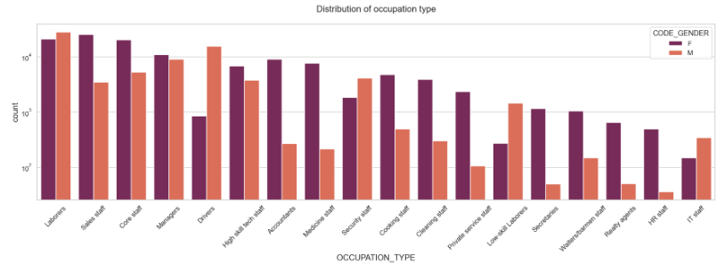
UNIVARIATE ANALYSIS - TARGET - 0 CASE (Occupation type distribution)
Highest count for female Laborers and sales staff.
Lowest female count for IT staff.
Higher male count for drivers.

Slide 13
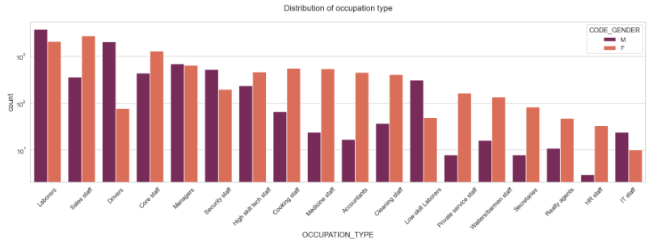
UNIVARIATE ANALYSIS - TARGET - 1 CASE (Occupation type distribution)
Highest count for male Laborers and drivers.
Lowest female count for IT staff.
Equal female and male count for managers.

Slide 14
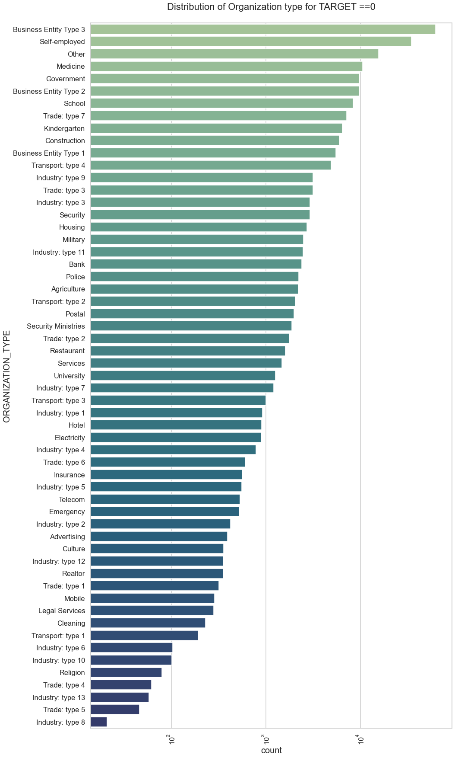
Highest count for Business entity type 3, Self employed and others.
Lowest count for trade type 5 and industry type 8.

Slide 15
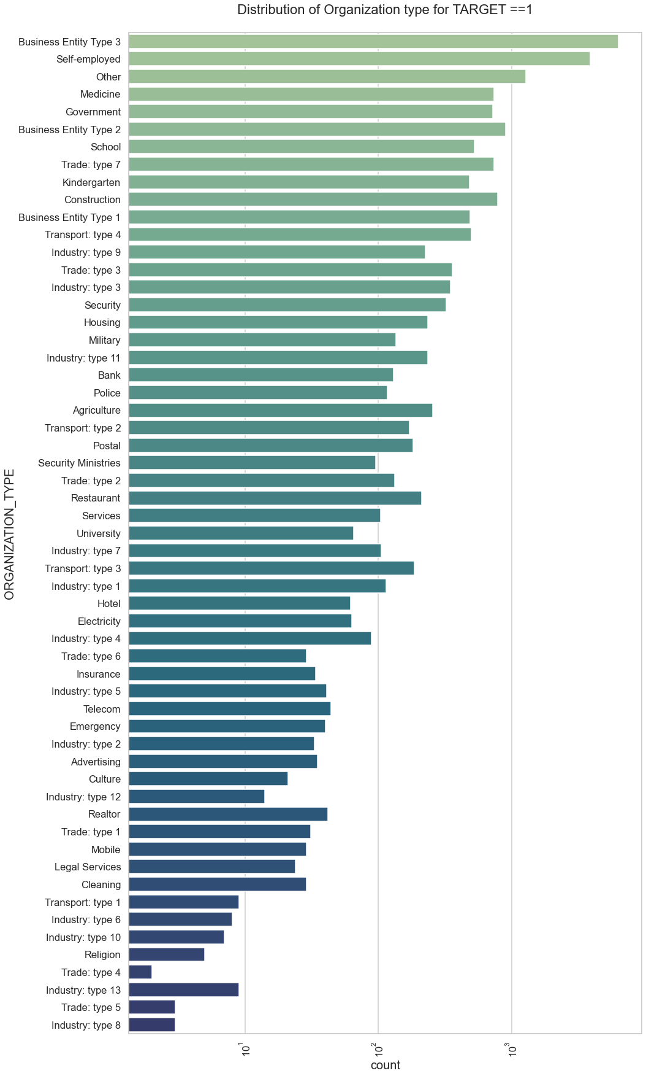
Highest count for Business, Self employed and others.
Lowest count for trade type 4 and industry type 15.

Slide 16
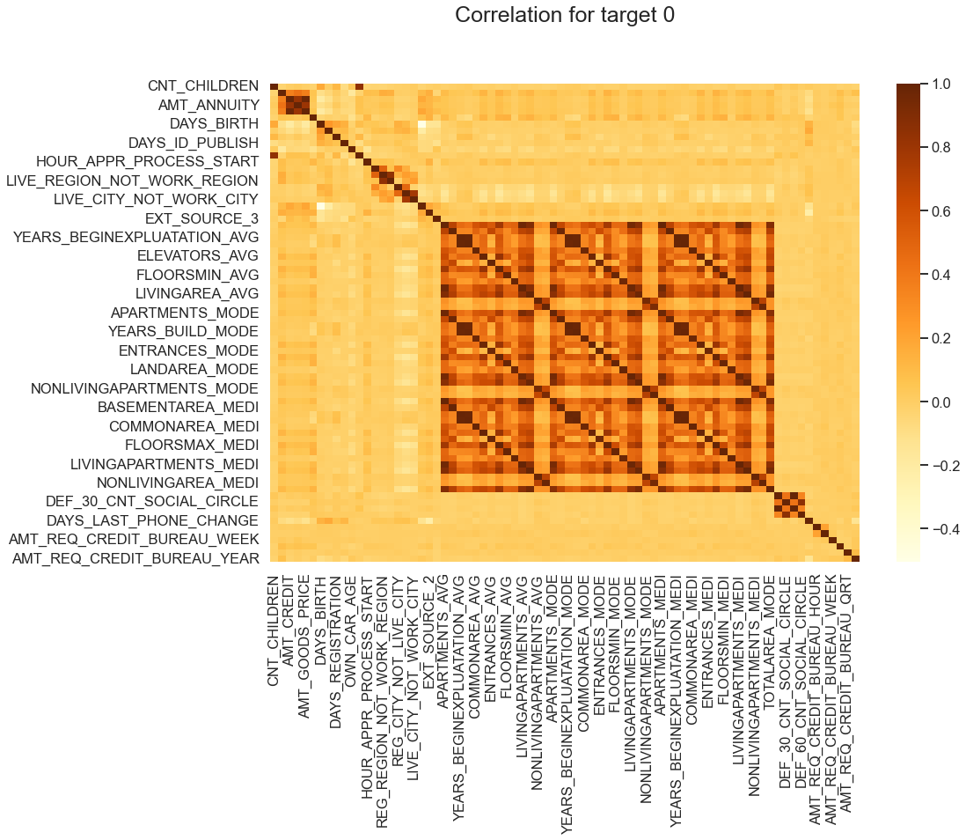
CORRELATION –TARGET 0
Loan annuity inversely proportional to Number of children the client has.
Credit amount more for client with less children
Less children client have in densely populated area.

Slide 17

CORRELATION –TARGET 1
Similar trend as Target - 0 case.
Mismatch with client address with children.

Slide 18
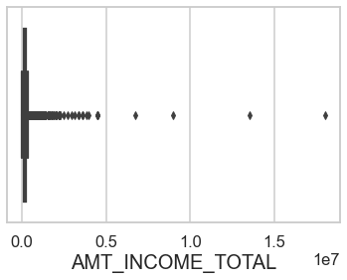
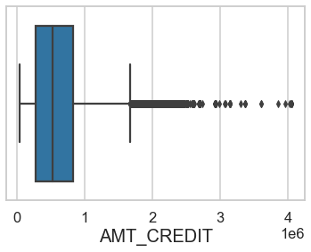
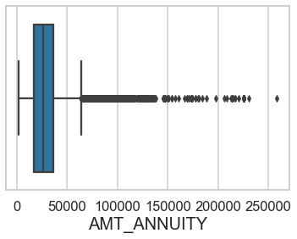
UNIVARIATE ANALYSIS - TARGET - 0 CASE (Box plot distribution)
Slimmest quartile range.
Outliers are observed for income amount.
First quartile smaller than third indicating most credits are in third quartile.
High number of outliers.
First quartile smaller than third indicating most annuity are in third quartile.
High number of outliers.

Slide 19
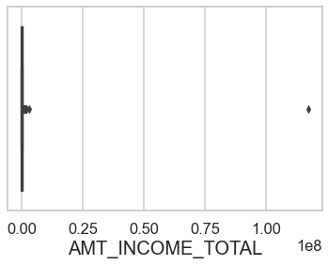
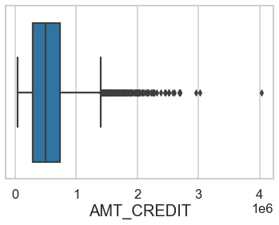
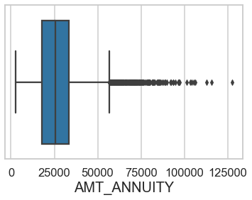
UNIVARIATE ANALYSIS - TARGET - 1 CASE (Box plot distribution)
Similar band width-first and third quartile range for annuity indicating customers are in between this range.
High number of outliers.
Slimmest quartile range.
One outlier observed.
First quartile smaller than third indicating most credits are in third quartile.
High number of outliers.

Slide 20
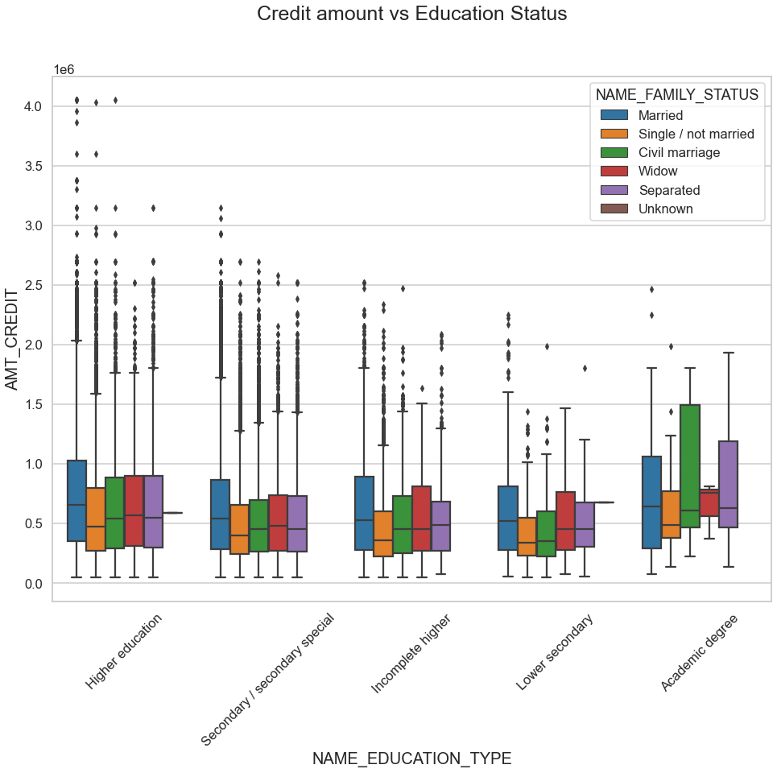
BIVARIATE ANALYSIS - TARGET - 0 CASE
Higher outliers for Higher education.
Higher credit amount for married, civil marriage, widow and separated.
Widow with academic degree have least quartile range.

Slide 21
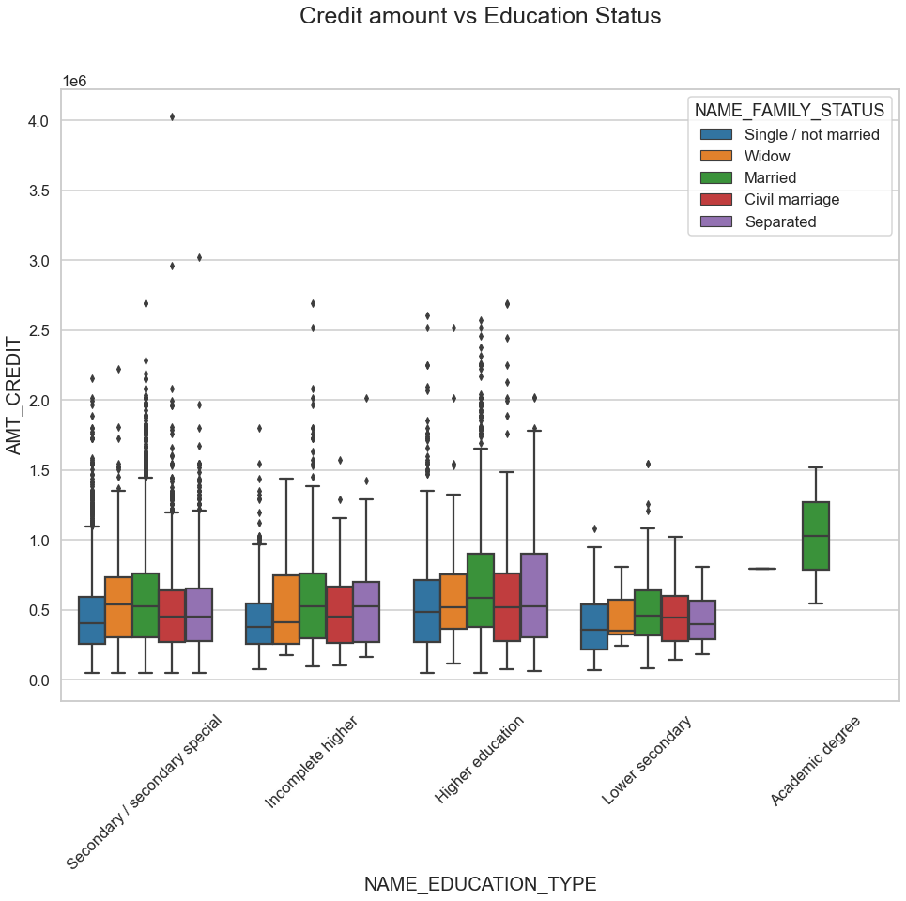
BIVARIATE ANALYSIS - TARGET - 1 CASE
Higher outliers for Higher and secondary education.
Higher credit amount for married, civil marriage, widow and separated.
Lower secondary have less amount credit range.

Slide 22
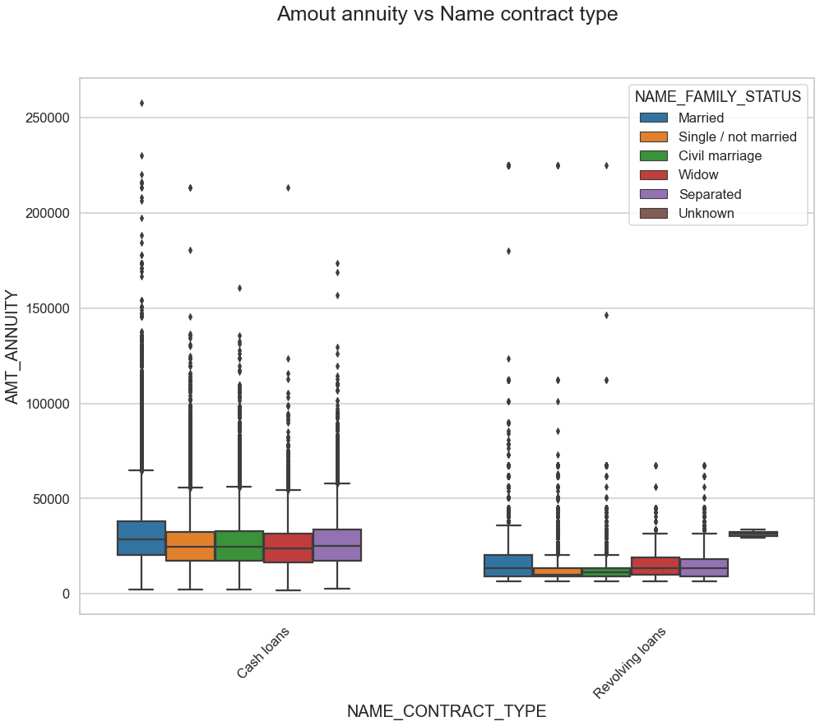
BIVARIATE ANALYSIS - TARGET - 0 CASE
Higher outliers for cash loans.
Higher amount annuity for married, civil marriage, widow and separated.
Single and civil marriage – least range under revolving loans.

Slide 23
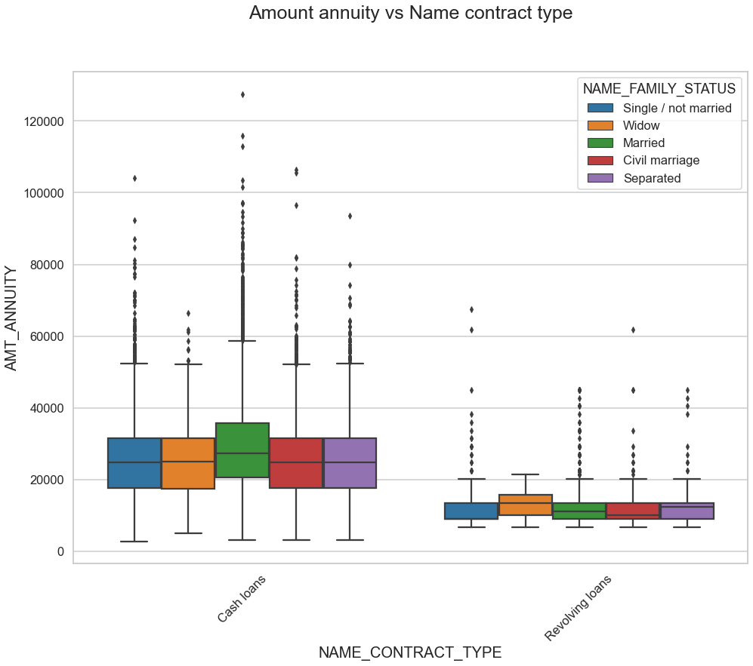
BIVARIATE ANALYSIS - TARGET - 1 CASE
Higher outliers for cash loans for married status.
Higher amount annuity for married family status.
Equal quartile range observed for married, civil marriage – and separated.

Slide 24
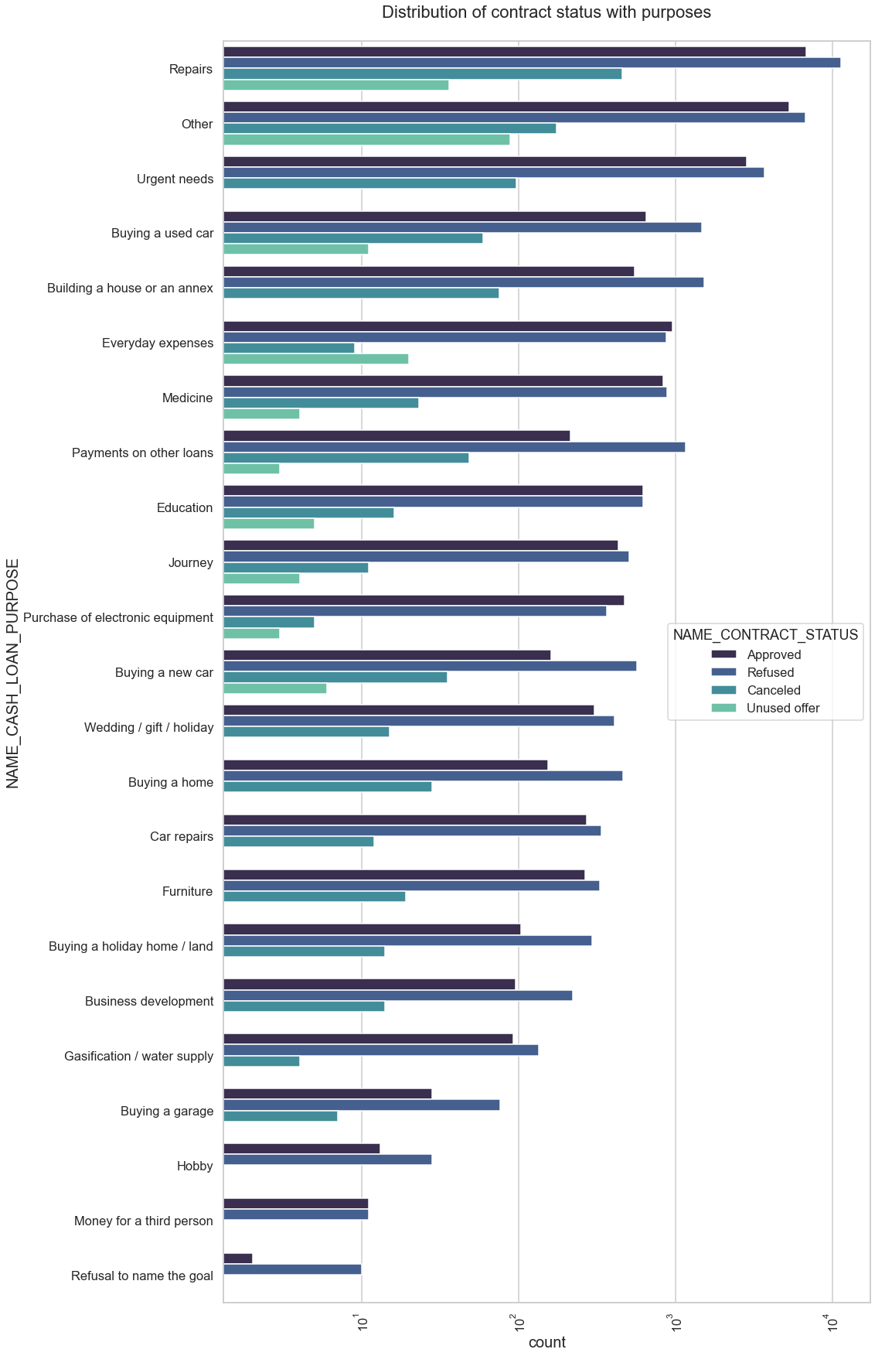
UNIVARIATE ANALYSIS – MERGED DATASET
Highest refuse count observed for repair loan.
Education and everyday expenses loan – equal approvals and rejections.
Buying home and car loans-equal rejection count.

Slide 25
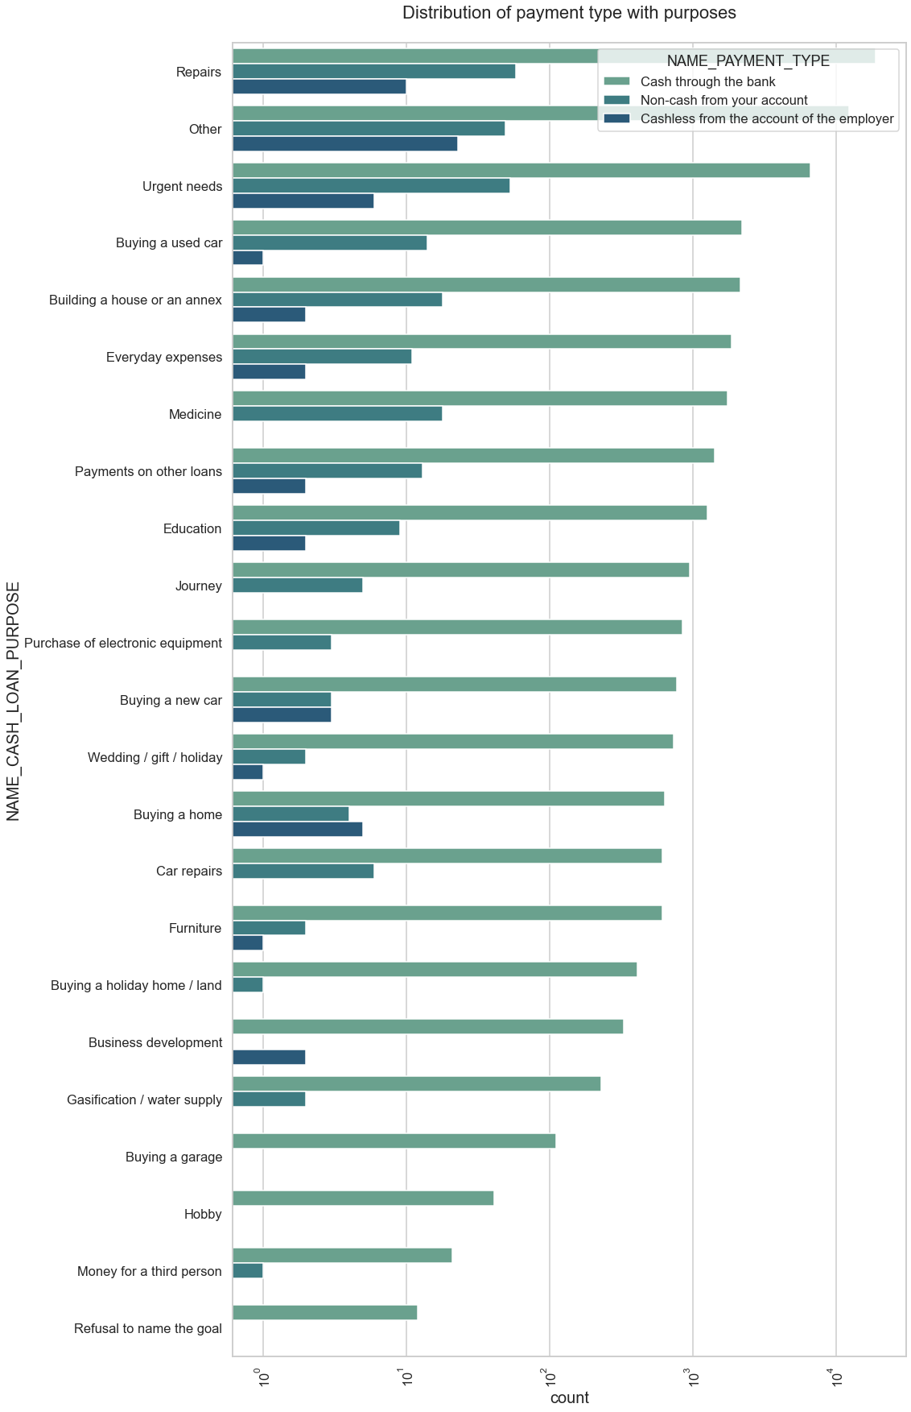
UNIVARIATE ANALYSIS – MERGED DATASET
Urgent needs – cash through bank.
Buying a new car – non cash and cashless.
Buying a house– cash through bank.

Slide 26
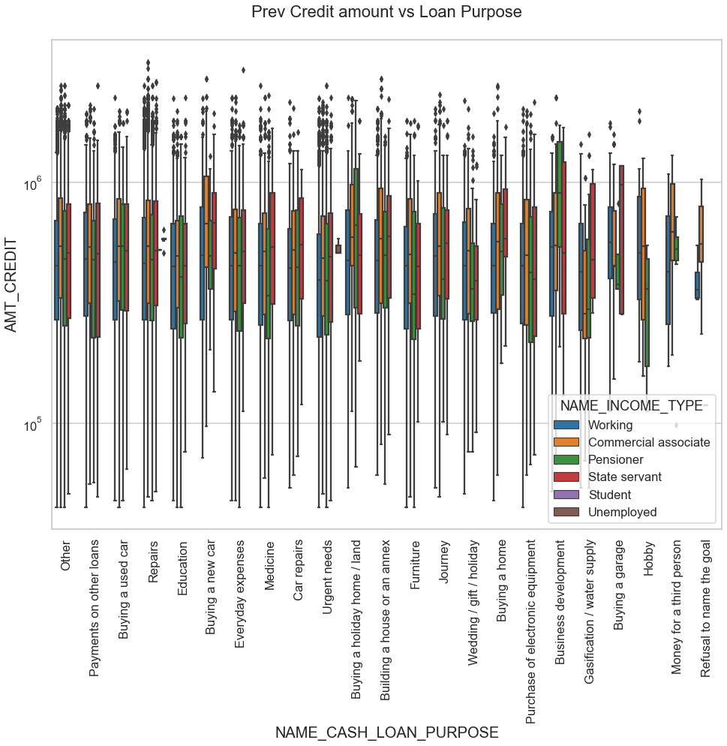
BIVARIATE ANALYSIS – MERGED DATASET
High Amount credit –pensioners for business development and buying holiday home land .
Unemployed- no amount credit.
High outliers for Repairs.

Slide 27
BIVARIATE ANALYSIS – MERGED DATASET
High Amount credit –pensioners for business development and buying holiday home land .
Unemployed- no amount credit.
High outliers for Repairs.

Slide 28
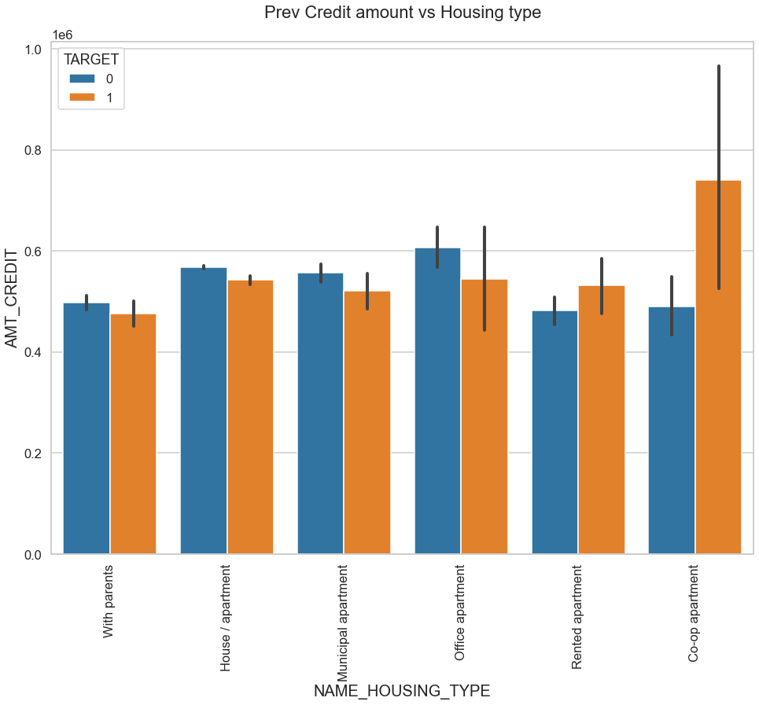
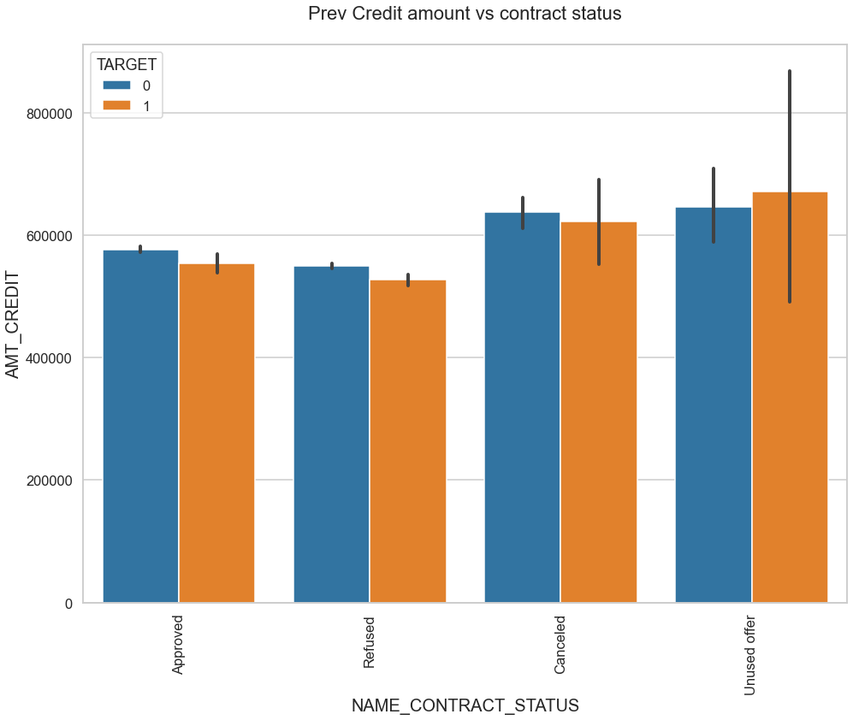
BIVARIATE ANALYSIS – MERGED DATASET
High Amount credit –coop apartment.
Least with parents.
Unused offer higher for approved credit amount.
Canceled credit same for target 0 and 1.

Slide 29
CONCLUSIONS
Banks should focus on the following variables:
Reduce the approval unused offer for higher credit amount.
Offer higher credit amount for people with parents.
Reduce the unsuccessful repair amount payments.
Focus on other income and contract status type than pensioners.
Target more on approval home loan and education.
Understand the loan cancellations and refusals happen and find a way to increase conversions.

